Slide 1



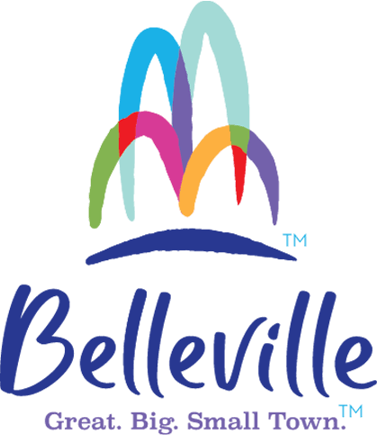
Strategic Plan
2023
Proprietary and Confidential. © 2023 Hickey Global. All Rights Reserved.

Slide 2
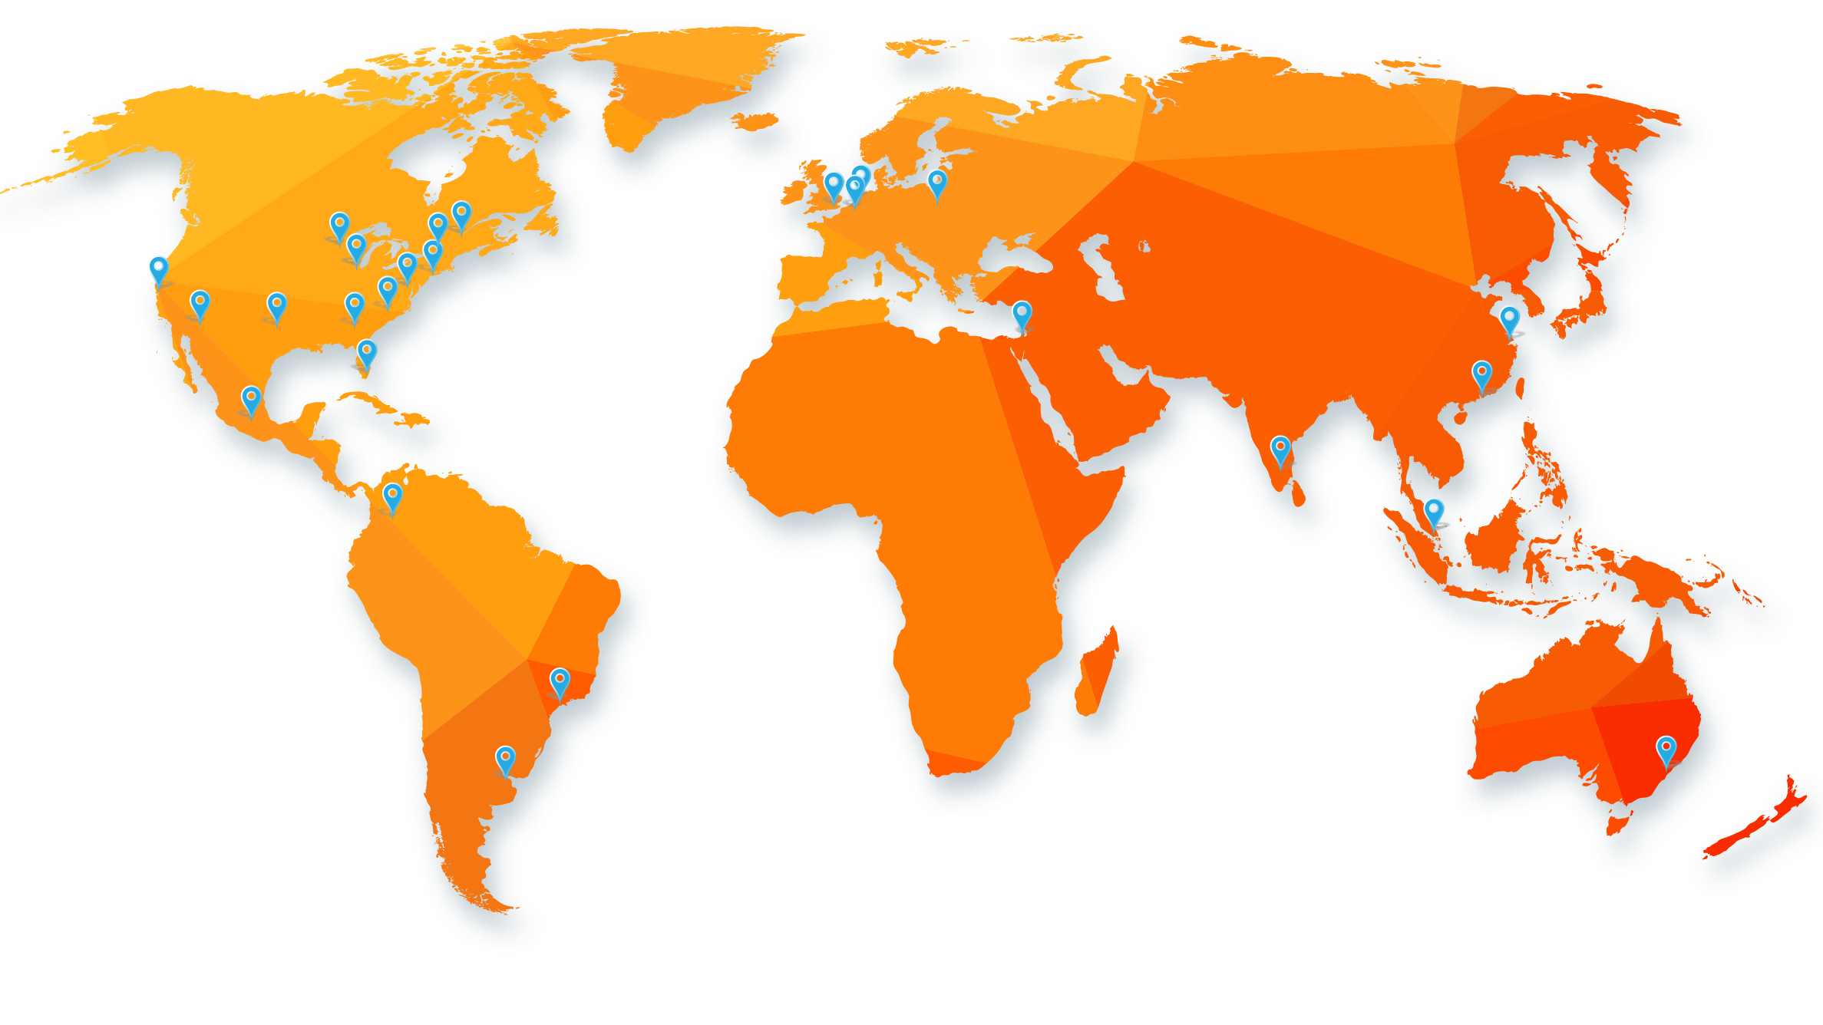
About Hickey
Decades of Success
We combine the largest independent site selection firm in the world, an international think tank, a foundation, and an economic development consulting practice into an integrated team to assist you.
HICKEY Offices Around the World
Hickey & Associates
Site Selection
Hickey Global
Economic Development Consulting
Hickey Institute
Thought Leadership
Michael P. Hickey Foundation
Giving Back
You work in a globally connected environment;
you need a global firm – Hickey.

Slide 3

About Barry
Loves Economic Development
28 years in the profession
Managed EDOs in communities from 10,000 to 5.4 million people
Worked in federal, university, city, county, regional, public/private, and consulting economic development and in the private sector
Served as founding executive of 3 economic development organizations
Past Chair of the International Economic Development Council (IEDC)
Graduate, Instructor and Dean of the Economic Development Institute at the University of Oklahoma
Founding Member of the Economic Development Research Partners (EDRP)
Senior Fellow of the American Leadership Forum
Recognized as a North Carolina Main Street Champion
International speaker on economic development
Barry I. Matherly, CEcD, FM, HLM
President & CEO
Hickey Global
3

Slide 4

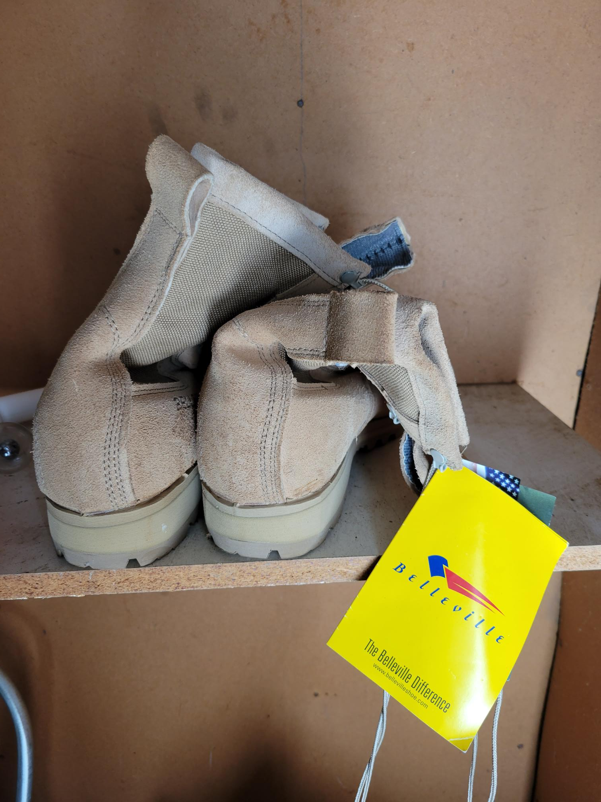
Belleville Connections
BUSINESS RETENTION
AND EXPANSION
ECOSYSTEM
MARKETING
AND BUSINESS ATTRACTION
MARKETING
ECOSYSTEM
PROPERTY
DEVELOPMENT
TALENT
TALENT

Slide 5
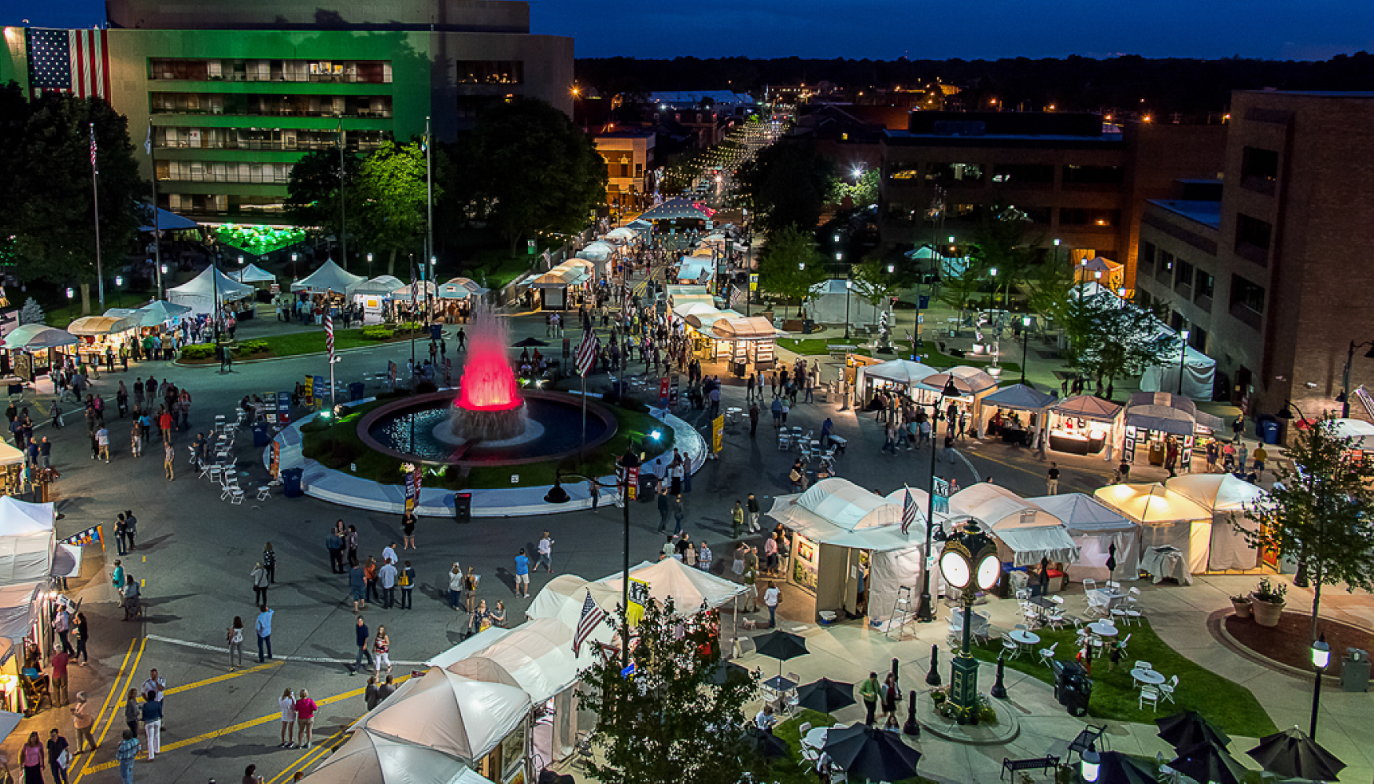



Table of Contents
Project Background
Vision & Mission
Components
Core Recommendations
Implementation
Strategies
Stakeholder Engagement
Economic Analysis
Cluster Study
Proprietary and Confidential. © 2023 Hickey Global. All Rights Reserved.

Slide 6

Executive Summary
Project Background
In 2022, the City of Belleville sought a partner to guide and create an economic development strategic plan and short-term implementation plan with the goal of advancing the future of the City of Belleville’s businesses, non-profits, and residents. The City recognized the need for an updated foundation of both quantitative and qualitative analysis to serve as the foundation for the development of strategies. To create this plan, Hickey Global has integrated economic research, stakeholder feedback, and economic development expertise to create a Strategic Plan that the City can use to encourage positive developments in the community and drive future economic growth. The resulting Plan is a comprehensive document that incorporates site selection indicators, public comments, current assets and infrastructure, policy, and the other myriad aspects of economic development and governance to yield a unique vision, mission, and guiding principles for the City of Belleville as well as the strategies for short, medium, and long-term implementation.
The City’s Vision
To further grow a vibrant, inviting, and recognized community that implements regional and community-based strategies to enhance sustainable growth and economic opportunities.

Slide 7
Executive Summary
Mission & Guiding Principles
MISSION
The development of plans, policies, and programs reflecting a structured and strategic commitment to retain, expand, and attract business and industry that contributes to economic growth throughout the community and region.
Guiding Principles
Support City Businesses and Workers
Focus on business attraction, retention and expansion with current and prospective partners and workforce through a focused engagement policy and a better understanding of their existing and future needs.
Ensure Equitable Economic Opportunities
A commitment to policy promoting both large and small businesses that provides an opportunity to promote economic advancement that is inclusive of the entire community.
Promote growth in existing and emerging business sectors
A commitment to best practices that support our business community thru policies and programs that target industry sectors contributing to growth, continued workforce development and a sustainable economic base.
Collaborate with local and regional partners
Commitment to local and regional partnerships that capitalize on resources and programs that contribute to sustainable economic growth throughout the City, County and region.
Celebrate and Promote Belleville
Effectively communicate a positive brand that increases Belleville’s potential to attract and retain residents, businesses and workers. Promote Belleville’s history, community support, strengths and diversity as a community asset that provides a high quality of life for our residents and business community.

Slide 8
Executive Summary
Components
Economic Analysis The economic analysis provides an up-to-date understanding of the current population, industry, and economic development needs of a community. For the City of Belleville, Hickey Global conducted an assessment of national employment, population and demographic trends, education, and employment statistics. The study also identifies Target Industries for the City to prioritize for business development activities. The findings from the economic analysis directly influenced the development of strategies and actions for the final plan.
Stakeholder Engagement
Representatives from Hickey Global undertook a series of interviews with key community stakeholders to identify local, regional, state, national and global dynamics and discuss issues to be addressed in the following strategic plan. The interview questions were used to orient stakeholders to key factors to be discussed in the Strategic Plan and yield input from individuals and groups with direct experience with the community’s business and political climate.
Strategies & Actions
The final strategies and proposed actions reflect the sum of information gathered from stakeholder interviews, follow-up research, and investigation of trends and resources. Strategies have been categorized into five Focus Areas:
Ecosystem
Property Development
Talent
Marketing and Business Attraction
Business Retention and Expansion
Each strategy has a corresponding action plan that demonstrates the need for economic development action, how to move forward with the action, the time frame by which the action can be expected to yield results, the intended impact, and the recommended parties to be responsible for implementation.

Slide 9
Executive Summary
Detailed Components
Quantitative Analysis
Unemployment Rate
Demographics
Commuting
Regional Income
Education
Employment
Occupation Specializations
Housing
Cluster Study
Cluster Concepts
Clusters and Linkages
Industry Group Review
Information Technology
Machinery & Equipment Manufacturing
Food Manufacturing
Metals & Chemical Products
Consumer Goods Manufacturing
Transportation & Warehousing
Appendices
Qualitative Analysis
Stakeholder Interviews
Stakeholder Survey
Strategic Plan
Vision and Mission
Guiding Principles
Strategic Focus Areas
Core Recommendations
Strategies/Actions
Need
Actions
Time Frame
Result
Recommended Partners

Slide 10

Strategies
Proprietary and Confidential. © 2021 Hickey Global. All Rights Reserved.

Slide 11

Strategic Focus Areas
BUSINESS RETENTION
AND EXPANSION
ECOSYSTEM
Belleville
Strategy
Buckets
MARKETING
AND BUSINESS ATTRACTION
MARKETING
ECOSYSTEM
PROPERTY
DEVELOPMENT
TALENT
TALENT

Slide 12
Core Recommendations
Business Retention and Expansion
Existing Relationships
Small Business
Work with existing targeted businesses to find strategic opportunities within their supply chain that will have mutual benefits for both the companies and our community. Realize these opportunities through expansion of business or attraction of a business that can meet the demand for goods/services.
Foster and maintain a partnership with federal, state, and regional economic development agencies; and other entities in order to encourage and facilitate economic growth.
Visit targeted businesses and conduct business retention and expansion survey to identify common needs, potential expansion projects and critical issues.
Increase relationships with existing businesses through service and knowledge of resources to assist in retention and expansion opportunities that will result in new capital investment and new jobs in the region. This includes sites and buildings, financial resources and incentives, infrastructure, market research, and talent development.
Coordinate bi-monthly meetings of the Plant Managers/Business Leaders to discuss common issues and challenges.
Create an export promotion strategy in partnership with the Illinois Department of Commerce Office of Trade & Investment (OTI) to introduce Belleville companies to foreign markets and help insulate the community's existing industry base from the threats of domestic market downturns.
Create a Milestone Recognition Program for key companies celebrating anniversaries at 5-year increments (5 year, 10 year, 15 year, etc.)
Celebrate existing business by creating a Business Appreciation Month.
Develop a legacy recognition program for firms in business locally for more than 25, 50 years, etc.
Develop action items to promote the retention, expansion, and attraction of small businesses in downtown areas.
Explore creating an Economic Gardening program to support Stage 2 entrepreneurs.
Coordinate a business walk of a dense business area.

Slide 13
Core Recommendations
Marketing and Attraction
targeted recruitment
City / Community
Determine specific subsets of current economic base. Use these targeted sectors as a directed focus for future development and business attraction efforts.
Develop a list of companies/contacts within each sector to target.
Identify targeted opportunities for business recruitment that match with the city’s needs and ability to support continued growth (e.g. Trade Shows, Marketing Missions, etc.).
Develop a site selection engagement program to increase prospect flow in city.
Create a site selection newsletter.
Enhance the physical and visual assets that set the city apart.
Empower communities to define their own sense of place and identify strategies to preserve, enhance, and/or grow placemaking efforts.
Develop marketing materials for the city to enhance business attraction efforts, quality of place, and community understanding.
Proactively market city to the region (could be done in conjunction with the City’s communication personnel)
Share successes and key messages through newsletters and social media
Create some sort of Festival Promotion buzz to highlight the local celebratory flare Ex. Most community festivals west of the Mississippi #festivalwithbelleville
organizational
Create/update marketing materials (Targeted Industry slicks, property slicks, etc.) to enhance business recruitment efforts.
Implement a new, multi-year economic development marketing plan that builds on the strengths of target business sectors, as well as leverages regional or statewide marketing. Within the plan, increase focus on economic diversification.
Market to the marketers (State, region, county).
Establish a City of Belleville Linked In page for economic development.
Host of FAM tour for state, regional , and county economic developers
Regularly communicate with brokers through email marketing program
Downtown revitalization
Promote the region’s downtown districts as the centers of their community and hub of economic activity, while creating a positive image that showcases each community’s unique characteristics.
Create a strong foundation for a sustainable downtown revitalization effort, including cultivating partnerships, community involvement, and resources for the region.

Slide 14
Core Recommendations
Ecosystem
Regional Collaboration
Explore mutually beneficial regional collaborations, including Scott Air Force Base to benefit area business base.
Collaborate with regional partners on key initiatives with regional impact, to include talent/workforce development, infrastructure planning, housing development (as it supports workforce development), and key stakeholder partnerships.
Encourage adoption of the International Property Maintenance Code in order to create a pristine and clean community for improved image and presentation of the city by: removing dumpsites, abandoned cars, dilapidated buildings, and other blighted conditions and by preventing future eyesores.
Update comprehensive plan to give residents and developers clear direction.
beautification
continued engagement
Inventory the walkability of downtown areas to identify gaps and needs (including sidewalks, crosswalks, storefront beautification, benches, lighting, etc.) for the purpose of seeking out funding to mitigate identified gaps/needs.
Inventory the vacant/available property for commercial redevelopment in each jurisdiction and develop a system for maintaining that inventory, including regular updates.
Downtown development committees could help determine what specific beautification efforts and blighted properties need to be addressed in their areas and devise a plan on how to address those efforts.
Explore a homecoming concept – history and traditions; capturing boomerangs.
Create Ombudsman/Liaison position in ED to help people navigate city development system.
Build local ambassador program of people who can highlight local strengths to target populations (newly stationed Air Force community, prospects, festival attendee out-of-towners)

Slide 15
Core Recommendations
Talent
Education/ workforce alignment
existing employer needs
Provide opportunities for educators to engage in business experiences such as educator externships, career shadowing, workforce discussion, etc.
Support the alignment and integration of education and workforce development in order to provide clear pathways for youth, post-secondary students, and adult job seekers.
Increase workforce participation by creating opportunities, incentivizing workforce participation, and removing barriers to employment.
Promote SWIC capabilities in high-demand fields such as Welding and Machinists. Align educational partners with emerging opportunities in cybersecurity and defense fields.
Work with existing targeted businesses to implement robotics, automation, AI, and other tactics that help increase efficiency and address the talent shortage problem.
Actively engage employers and stakeholders to drive innovative workforce solutions across the region.
Identify private, public, state and nonprofit talent resources and any relevant specializations available to city businesses.
Collaborate with key local HR departments to understand their talent needs.
Work with local businesses and partners to identify job placement opportunities for trailing (military) spouses.
Develop a regional brand to market quality of life and cost of living benefits to attract remote workers to the area. Once beautification and Main Street initiatives are underway, incorporate these investments into marketing or promotional materials.

Slide 16
Core Recommendations
Property Development
Process Improvement
Residential development
Make the development processes more business and citizen friendly (inspections, engineering, permitting).
Review and compile a comprehensive listing of current county, city and state license standards and processes for residential contractors, for the purpose of identifying needed updates and gaps to be filled.
Develop and promote new local and state incentives and federal tax credits to property owners in the downtown areas and support rehabilitation and redevelopment of historic properties.
Improve relationships with current real estate partners and local participants to ensure accurate and current availabilities of property for both business and residential opportunities.
Conduct a needs assessment to determine specific housing needs in the city.
Utilizing the results of the needs assessment, create a strategy for how to address housing needs, including the exploration of incentive programs and other programs best suited to addressing the housing needs identified.
Form a housing committee to educate the public on available housing options, conduct a comprehensive review of building codes and ordinances for the area, and to explore methods to increase housing stock throughout the region.
Commercial/ industrial development
Expand and diversify the availability of developable commercial/industrial property to ensure the competitiveness of the entire area.
Encourage the improvement of infrastructure availability and capacity to meet the needs of targeted sector businesses; meet quarterly with utility and infrastructure entities to ensure a common development vision for the strategic growth in areas with economic development potential.
Renew interest in manufacturing and distribution - planning and development for parcels along 15.
Host a real estate and developer event in city to showcase available site and buildings.
Analyze and rank current and potential business and office park sites for future development.
Send regular (quarterly?) newsletter to real estate-interested communities (state EDO, regional brokers, firms in CRM with matching site or building interests)

Slide 17
Core Recommendations
Business Retention and Expansion
Existing Relationships
Work with existing targeted businesses to find strategic opportunities within their supply chain that will have mutual benefits for both the companies and our community. Realize these opportunities through expansion of business or attraction of a business that can meet the demand for goods/services.
Foster and maintain a partnership with federal, state, and regional economic development agencies; and other entities in order to encourage and facilitate economic growth.
Visit targeted businesses and conduct business retention and expansion survey to identify common needs, potential expansion projects and critical issues.
Increase relationships with existing businesses through service and knowledge of resources to assist in retention and expansion opportunities that will result in new capital investment and new jobs in the region. This includes sites and buildings, financial resources and incentives, infrastructure, market research, and talent development.
Coordinate bi-monthly meetings of the Plant Managers/Business Leaders to discuss common issues and challenges.
Create an export promotion strategy in partnership with the Illinois Department of Commerce Office of Trade & Investment (OTI) to introduce Belleville companies to foreign markets and help insulate the community's existing industry base from the threats of domestic market downturns.
Create a Milestone Recognition Program for key companies celebrating anniversaries at 5-year increments (5 year, 10 year, 15 year.
Celebrate existing business by creating a Business Appreciation Month.
Develop a legacy recognition program for firms in business locally for more than 25, 50 years, etc.

Slide 18
Core Recommendations
Business Retention and Expansion
Small Business
Develop action items to promote the retention, expansion, and attraction of small businesses in downtown areas.
Explore creating an Economic Gardening program to support Stage 2 entrepreneurs.
Coordinate a business walk of a dense business area.

Slide 19
Core Recommendations
Marketing and Attraction
targeted recruitment
Determine specific subsets of current economic base. Use these targeted sectors as a directed focus for future development and business attraction efforts.
Develop a list of companies/contacts within each sector to target.
Identify targeted opportunities for business recruitment that match with the city’s needs and ability to support continued growth (e.g. Trade Shows, Marketing Missions, etc.).
Develop a site selection engagement program to increase prospect flow in city.
Create a site selection newsletter.

Slide 20
Core Recommendations
Marketing and Attraction
organizational
Create/update marketing materials (Targeted Industry slicks, property slicks, etc.) to enhance business recruitment efforts.
Implement a new, multi-year economic development marketing plan that builds on the strengths of target business sectors, as well as leverages regional or statewide marketing. Within the plan, increase focus on economic diversification.
Market to the marketers (State, region, county).
Establish a City of Belleville Linked In page for economic development.
Host of FAM tour for state, regional , and county economic developers
Regularly communicate with brokers through email marketing program

Slide 21
Core Recommendations
Marketing and Attraction
City / Community
Enhance the physical and visual assets that set the city apart.
Empower communities to define their own sense of place and identify strategies to preserve, enhance, and/or grow placemaking efforts.
Develop marketing materials for the city to enhance business attraction efforts, quality of place, and community understanding.
Proactively market city to the region (could be done in conjunction with the City’s communication personnel)
Share successes and key messages through newsletters and social media
Create some sort of Festival Promotion buzz to highlight the local celebratory flare Ex. Most community festivals west of the Mississippi #festivalwithbelleville

Slide 22
Core Recommendations
Marketing and Attraction
Downtown revitalization
Promote the region’s downtown districts as the centers of their community and hub of economic activity, while creating a positive image that showcases each community’s unique characteristics.
Create a strong foundation for a sustainable downtown revitalization effort, including cultivating partnerships, community involvement, and resources for the region.

Slide 23
Core Recommendations
Ecosystem
Regional Collaboration
Explore mutually beneficial regional collaborations, including Scott Air Force Base to benefit area business base.
Collaborate with regional partners on key initiatives with regional impact, to include talent/workforce development, infrastructure planning, housing development (as it supports workforce development), and key stakeholder partnerships.

Slide 24
Core Recommendations
Ecosystem
beautification
Inventory the walkability of downtown areas to identify gaps and needs (including sidewalks, crosswalks, storefront beautification, benches, lighting, etc.) for the purpose of seeking out funding to mitigate identified gaps/needs.
Inventory the vacant/available property for commercial redevelopment in each jurisdiction and develop a system for maintaining that inventory, including regular updates.
Downtown development committees could help determine what specific beautification efforts and blighted properties need to be addressed in their areas and devise a plan on how to address those efforts.
Encourage adoption of the International Property Maintenance Code in order to create a pristine and clean community for improved image and presentation of the city by: removing dumpsites, abandoned cars, dilapidated buildings, and other blighted conditions and by preventing future eyesores.
Update comprehensive plan to give residents and developers clear direction.

Slide 25
Core Recommendations
Ecosystem
continued engagement
Explore a homecoming concept – history and traditions; capturing boomerangs.
Create Ombudsman/Liaison position in ED to help people navigate city development system.
Build local ambassador program of people who can highlight local strengths to target populations (newly stationed Air Force community, prospects, festival attendee out-of-towners)

Slide 26
Core Recommendations
Talent
Education/ workforce alignment
Provide opportunities for educators to engage in business experiences such as educator externships, career shadowing, workforce discussion, etc.
Support the alignment and integration of education and workforce development in order to provide clear pathways for youth, post-secondary students, and adult job seekers.
Increase workforce participation by creating opportunities, incentivizing workforce participation, and removing barriers to employment.
Promote SWIC capabilities in high-demand fields such as Welding and Machinists. Align educational partners with emerging opportunities in cybersecurity and defense fields.

Slide 27
Core Recommendations
Talent
existing employer needs
Work with existing targeted businesses to implement robotics, automation, AI, and other tactics that help increase efficiency and address the talent shortage problem.
Actively engage employers and stakeholders to drive innovative workforce solutions across the region.
Identify private, public, state and nonprofit talent resources and any relevant specializations available to city businesses.
Collaborate with key local HR departments to understand their talent needs.
Work with local businesses and partners to identify job placement opportunities for trailing (military) spouses.
Develop a regional brand to market quality of life and cost of living benefits to attract remote workers to the area. Once beautification and Main Street initiatives are underway, incorporate these investments into marketing or promotional materials.

Slide 28
Core Recommendations
Property Development
Process Improvement
Make the development processes more business and citizen friendly (inspections, engineering, permitting).
Review and compile a comprehensive listing of current county, city and state license standards and processes for residential contractors, for the purpose of identifying needed updates and gaps to be filled.
Develop and promote new local and state incentives and federal tax credits to property owners in the downtown areas and support rehabilitation and redevelopment of historic properties.

Slide 29
Core Recommendations
Property Development
Commercial/ industrial development
Expand and diversify the availability of developable commercial/industrial property to ensure the competitiveness of the entire area.
Encourage the improvement of infrastructure availability and capacity to meet the needs of targeted sector businesses; meet quarterly with utility and infrastructure entities to ensure a common development vision for the strategic growth in areas with economic development potential.
Renew interest in manufacturing and distribution - planning and development for parcels along 15.
Host a real estate and developer event in city to showcase available site and buildings.
Analyze and rank current and potential business and office park sites for future development.
Send regular (quarterly?) newsletter to real estate-interested communities (state EDO, regional brokers, firms in CRM with matching site or building interests)

Slide 30
Core Recommendations
Property Development
Residential development
Improve relationships with current real estate partners and local participants to ensure accurate and current availabilities of property for both business and residential opportunities.
Conduct a needs assessment to determine specific housing needs in the city.
Utilizing the results of the needs assessment, create a strategy for how to address housing needs, including the exploration of incentive programs and other programs best suited to addressing the housing needs identified.
Form a housing committee to educate the public on available housing options, conduct a comprehensive review of building codes and ordinances for the area, and to explore methods to increase housing stock throughout the region.

Slide 31
Implementation Guide
Action Plan
Short-Term Short-term strategies within the context of an economic development strategic plan typically refer to actions and initiatives that can be promptly implemented to achieve immediate results or address pressing issues, typically within 1-3 years. These strategies are designed to have a relatively quick impact, laying the groundwork for long-term success.
Medium-Term
Medium-term strategies encompass a range of initiatives aimed at fostering sustainable growth and resilience over an intermediate timeframe, usually 3-5 years. These strategies involve more substantial and enduring efforts compared to short-term interventions. The focus for these strategies is on building a solid foundation for long-lasting prosperity, laying the groundwork for sustained economic development in Belleville.
Long-Term
Long-term strategies are envisioned as transformative initiatives designed to shape the city's economic landscape over an extended period, looking 5 years and beyond. These strategies entail comprehensive and forward-looking measures, which could position Belleville for sustained economic prosperity over many years. Long-term strategies aim to create a resilient and adaptable economic development ecosystem that can withstand evolving challenges and propel Belleville into a prosperous future.

Slide 32
Short Term Strategies
1-3 Year Implementation Timeline
Existing Business Retention Visits
Business Leader Roundtable
Belleville Business Walk
Targeted Sector Development
Sector-Specific Company Lists
Business Recruitment Opportunities
Marketing Materials Update/Creation
City of Belleville Marketing Materials
Market to the Marketers
Fam Tour(s)
Site Selection Engagement Program
LinkedIn
Ombudsman Position
Local Ambassador Program
Partner Relationships
Downtown District Promotion
SWIC Capability Promotion
Available Talent Resources
Downtown Development Committee
Property Maintenance Code
Email Marketing to Brokers
Comprehensive Licensure Standards List
Real Estate Newsletter

Slide 33
Medium Term Strategies
3-5 Year Implementation Timeline
Future Development Opportunities
Local Talent Needs
Economic Development Partnerships
Existing Business Services
Small Business Development
Business Appreciation Month
Multi-Year Marketing Plan
Regional Collaboration
Downtown Revitalization
Placemaking
Belleville Homecoming
Education and Workforce Alignment
Process Improvement
Infrastructure Improvements
Real Estate Developer Event
Needs Assessment
Housing Committee

Slide 34
Long Term Strategies
5+ Year Implementation Timeline
Existing Business Supply Chain Opportunities
Export Promotion Strategy
Economic Gardening Program
Asset Enhancement
Educator Externships
Increase of Workforce Participation
Existing Business Talent Shortage
Innovative Workforce Solutions
Trailing Spouses
Remote Worker Attraction
Incentives and Tax Credits
Expansion of Available Property
Route 15 Parcels

Slide 35

Short-Term
Proprietary and Confidential. © 2021 Hickey Global. All Rights Reserved.

Slide 36
Existing Business Retention Visits
Action Plan
The City of Belleville, Illinois, recognizes the imperative need to foster economic growth and ensure the vitality of their local business community. To achieve this, it is crucial to understand the specific needs, expansion potential, and pressing issues faced by local businesses. This necessitates a proactive approach through business retention and expansion (BRE) initiatives, starting with conducting surveys and engaging with targeted businesses.
ACTIONS To meet this need, Belleville’s Economic Development team should start a comprehensive business retention and expansion program. This program would proactively reach out to targeted businesses in the community and conduct in-depth, one-on-one surveys to gather insights into their needs, expansion plans, and challenges. The team would collect this information systematically and comprehensively from a wide range of businesses in different sectors. This information would form the basis of the city’s strategy to create a supportive environment tailored to the specific needs of local businesses, which would promote sustainable growth.
TIME FRAME Short Term
RESULT To gain valuable insights into the needs, expansion opportunities, and challenges faced by our local businesses.
RECOMMENDED PARTNERS
City of Belleville Economic Development
NEED

Slide 37
Business Leader Roundtable
Action Plan
NEED
The City of Belleville recognizes the pressing need for enhanced coordination and collaboration among local businesses, particularly plant managers and business leaders. Bi-monthly meetings serve as a vital platform to bring these stakeholders together to discuss common issues and challenges they face. Such gatherings provide an opportunity to share insights, best practices, and solutions, ultimately fostering a more supportive business environment and promoting growth within the community.
ACTIONS Belleville should facilitate and encourage the regular convening of bi-monthly meetings among plant managers and business leaders in the city. These meetings should provide a space for open and constructive dialogue, enabling participants to address shared challenges, explore potential synergies, and jointly develop strategies to overcome obstacles. By promoting a culture of collaboration and knowledge exchange, the city can empower its business community to navigate challenges effectively and harness opportunities for expansion and improvement.
TIME FRAME Short Term
RESULT Coordinating bi-monthly meetings of plant managers and business leaders is expected to lead to a more resilient and closely-knit business community in Belleville. These interactions will foster a sense of mutual support and cooperation, ultimately resulting in innovative problem-solving, shared resources, and an improved business environment. Consequently, the local economy is likely to benefit from enhanced growth and the development of strategies that address common challenges effectively.
RECOMMENDED PARTNERS
City of Belleville Economic Development, Community Development

Slide 38
Belleville Business Walk
Action Plan
NEED
The City of Belleville recognizes the importance of maintaining close relationships with its existing businesses and understanding their needs to ensure their growth and retention. A coordinated business walk through a dense business area is needed to directly engage with business owners, gain valuable insights into their challenges, and identify opportunities for support. This proactive approach will help strengthen the city's connection with local enterprises and create a conducive environment for their continued expansion and success.
ACTIONS Belleville should organize and execute a coordinated business walk through a densely populated business area. This initiative should involve representatives from the City Economic Development Department, local business associations, and relevant city officials. During the walk, participants should interact with business owners, assess their needs, and provide information on available resources, incentives, and support. The goal is to foster direct communication and build a stronger partnership between the city and its business community.
TIME FRAME Short Term
RESULT Conducting a business walk through a dense business area is expected to yield closer relationships between the city and local businesses. Business owners will gain a better understanding of available resources and support, while the city will obtain valuable insights into the challenges faced by these enterprises. As a result, this engagement should lead to enhanced retention, expansion opportunities, and a more robust and thriving business environment in Belleville.
RECOMMENDED PARTNERS
City of Belleville Economic Development, Community Development

Slide 39
Targeted Sector Development
Action Plan
The City of Belleville recognizes the imperative need to strategically focus its economic development efforts on specific targeted sectors. By aligning development and business attraction initiatives with sectors such as Information Technology, Machinery and Equipment Manufacturing, Food Manufacturing, Metals and Chemical Products, Consumer Goods Manufacturing, and Transportation and Warehousing, Belleville can maximize its resources and opportunities to promote growth, create jobs, and enhance the local economy. This targeted approach ensures that the city's economic development strategies are in sync with its competitive strengths and market opportunities.
ACTIONS Belleville should concentrate its economic development efforts on the identified targeted sectors. Actions should include the development of sector-specific marketing campaigns and incentives, targeted outreach to businesses within these sectors, the creation of sector-specific workforce development programs, and support for infrastructure improvements that benefit these sectors. By focusing on these key sectors, the city can tailor its business attraction efforts to the unique needs and strengths of each, creating an attractive environment for businesses in these sectors to establish or expand their operations in Belleville.
TIME FRAME Short Term
RESULT The strategic alignment of economic development efforts with the identified targeted sectors is expected to yield a more diversified and prosperous local economy. Belleville should see an influx of businesses in these sectors, leading to job creation, increased capital investment, and a stronger, more resilient business landscape. This focused approach ensures that the city is well-positioned to capitalize on the strengths and opportunities present in each sector.
RECOMMENDED PARTNERS
City of Belleville Economic Development
NEED

Slide 40
Sector-Specific Company List(s)
Action Plan
The City of Belleville recognizes the importance of strategic and targeted business attraction efforts to stimulate economic growth. To effectively attract and engage businesses in sectors aligned with their economic development goals, it is essential to develop a curated list of companies and contacts within each sector. This targeted approach ensures that outreach efforts are focused on the most promising prospects, thereby increasing the likelihood of success in attracting businesses that align with your economic priorities.
ACTIONS Belleville should proactively compile a list of companies and contacts within each sector identified for business attraction. This process should involve the City Economic Development Department working closely with industry experts, local business associations, and regional economic development organizations to identify and categorize potential targets. Subsequently, the city should initiate tailored outreach campaigns and engagement strategies to connect with these companies and contacts, showcasing the advantages of establishing or expanding their operations in Belleville.
TIME FRAME Short Term
RESULT The development of targeted lists of companies and contacts within each sector should lead to more effective and efficient business attraction efforts. By focusing on prospects with a demonstrated alignment to our economic development priorities, the city can anticipate an increased success rate in attracting businesses from these sectors. The expected result is a strengthened and diversified local economy, characterized by job creation and increased capital investment.
RECOMMENDED PARTNERS
City of Belleville Economic Development
NEED

Slide 41
Business Recruitment Opportunities
Action Plan
The City of Belleville recognizes the need to identify strategic opportunities for business recruitment that align with the city's capacity and resources to sustain and foster continued growth. By carefully assessing and targeting specific opportunities, such as trade shows and marketing missions, Belleville can optimize its business attraction efforts to match its unique strengths and potential, thereby increasing the city's competitiveness in attracting businesses that contribute to its economic vitality.
ACTIONS Belleville should conduct a thorough analysis to identify targeted opportunities for business recruitment that align with the city's needs and ability to support ongoing growth. This entails working closely with the City Economic Development Department and local business associations to pinpoint events and initiatives, such as trade shows, industry-specific conventions, and marketing missions, that align with Belleville's strategic goals. Subsequently, the city should develop tailored strategies and campaigns to promote these opportunities, showcasing the advantages of locating or expanding businesses in Belleville.
TIME FRAME Short Term
RESULT By focusing on identified opportunities that align with the city's strengths and capacity for growth, Belleville should anticipate an increase in the success rate of its business recruitment efforts. As a result, the city can expect to attract businesses that are well-suited to its resources and priorities, leading to job creation, increased capital investment, and overall economic growth.
RECOMMENDED PARTNERS
City of Belleville Economic Development
NEED

Slide 42
Marketing Materials Update/Creation
Action Plan
The City of Belleville recognizes the vital importance of having up-to-date and compelling marketing materials to bolster its business recruitment efforts. To effectively attract new businesses and investments, the city must create and update marketing materials, including targeted industry slicks and property slicks. These materials serve as powerful tools for showcasing Belleville's strengths, resources, and opportunities, making a compelling case for businesses to choose the city as their preferred location.
ACTIONS Belleville should collaborate with the City Economic Development Department and engage local graphic designers and marketing experts to create and update marketing materials that are tailored to different industry sectors. These materials should highlight the city's advantages, available properties, incentives, and workforce resources, providing comprehensive information that speaks directly to the needs of potential investors. By maintaining a library of up-to-date and well-designed marketing materials, the city can enhance its business recruitment efforts and effectively communicate the benefits of locating or expanding in Belleville.
TIME FRAME Short Term
RESULT The creation and updating of targeted marketing materials is expected to significantly improve the city's ability to attract businesses and investments. By providing comprehensive and visually appealing resources, Belleville can make a compelling case for prospective investors and businesses, resulting in increased interest, inquiries, and ultimately, successful business recruitment.
RECOMMENDED PARTNERS
City of Belleville Economic Development, PR & Marketing
NEED

Slide 43
City of Belleville Marketing Materials
Action Plan
The City of Belleville recognizes the critical need to develop comprehensive marketing materials that serve a multifaceted purpose. These materials should enhance business attraction efforts, elevate the quality of place, and improve community understanding. By proactively marketing the city to the region through these materials, sharing successes and key messages via newsletters and social media, and creating a festival promotion buzz, Belleville can amplify its appeal to businesses, residents, and visitors, fostering a stronger sense of community pride and economic vitality.
ACTIONS Belleville should collaborate with its communication personnel and other relevant departments to create a suite of marketing materials. These materials should highlight the city's unique strengths, available business opportunities, quality of life, and the celebratory spirit of Belleville. They should include brochures, videos, websites, and social media content. The city should also launch a Festival Promotion campaign to showcase its rich festival culture. These materials should be shared actively through newsletters, social media channels, and targeted outreach to regional stakeholders and businesses.
TIME FRAME Short Term
RESULT The development and dissemination of comprehensive marketing materials, along with the Festival Promotion campaign, is expected to have a transformative impact. It will increase the visibility of Belleville, attract businesses, residents, and visitors, and create a sense of local pride. The city can anticipate enhanced business attraction efforts, a more vibrant quality of place, and an improved understanding of the community. This, in turn, should lead to economic growth and a more engaged and connected community.
RECOMMENDED PARTNERS
City of Belleville Economic Development, PR & Marketing
NEED

Slide 44
Market to the Marketers
Action Plan
The City of Belleville recognizes the importance of marketing itself strategically to key stakeholders, specifically targeting marketers at the state, regional, and county levels. By doing so, Belleville can ensure that its economic potential is effectively communicated to those who are best positioned to promote it. This approach is vital in raising awareness, fostering collaboration, and generating interest among these influential marketing professionals who can drive business attraction and investment within the city.
ACTIONS Belleville should develop a comprehensive marketing strategy tailored to reach marketers at the state, regional, and county levels. This strategy should include targeted outreach, participation in relevant industry events, and the dissemination of promotional materials that emphasize the city's unique strengths, resources, and opportunities. The city should also foster relationships and partnerships with marketing professionals and entities at these levels to ensure that Belleville's economic potential is effectively communicated and promoted.
TIME FRAME Short Term
RESULT By marketing to marketers at the state, regional, and county levels, Belleville should anticipate increased awareness and interest in the city's economic opportunities. This approach is expected to foster collaboration and drive business attraction efforts more effectively. As a result, the city can expect an increase in inquiries, investment, and the establishment of businesses within its borders, leading to economic growth and prosperity.
RECOMMENDED PARTNERS
City of Belleville Economic Development, PR & Marketing, Intersect Illinois
NEED

Slide 45
Fam Tour(s)
Action Plan
The City of Belleville recognizes the need to strengthen relationships and foster collaboration with economic development professionals at the state, regional, and county levels. Hosting a familiarization (FAM) tour for these economic developers is a vital initiative, as it offers an opportunity to showcase Belleville's economic potential, resources, and investment opportunities. By doing so, the city can promote a cohesive approach to economic development, ensuring alignment with the broader development goals of the region and state.
ACTIONS Belleville should organize and host a FAM tour specifically designed for state, regional, and county economic developers. The tour should offer a comprehensive view of the city's economic strengths, available properties, key industries, and collaborative initiatives. Activities should include site visits, meetings with local business leaders, and presentations on economic development strategies. This tour aims to establish valuable connections and foster a deeper understanding of Belleville's potential, encouraging future collaboration on economic development projects.
TIME FRAME Short Term
RESULT Hosting a FAM tour for economic developers from the state, region, and county is expected to enhance Belleville's visibility and reputation in the economic development community. This initiative should lead to stronger relationships, increased collaboration, and a shared commitment to promoting the city's economic growth. The result will be more comprehensive and cohesive economic development efforts that align with the broader goals of the region and state.
RECOMMENDED PARTNERS
City of Belleville Economic Development, Community Development, PR & Marketing, Intersect Illinois
NEED

Slide 46
Site Selection Engagement Program
Action Plan
The City of Belleville recognizes the necessity of actively engaging site selection professionals and potential businesses to increase the flow of prospects considering the city for investment and expansion. To address this need, it is crucial to develop a comprehensive site selection engagement program, which includes a site selection newsletter. By implementing such a program, Belleville can proactively reach out to prospective investors, disseminate information on available sites and resources, and create a more inviting and informed environment for businesses looking to establish or expand their operations.
ACTIONS Belleville should establish a site selection engagement program, led by the City Economic Development Department in collaboration with local business associations and relevant industry experts. This program should incorporate a site selection newsletter that provides timely information on available properties, incentives, workforce development, and other pertinent resources. It should also include personalized outreach to site selection professionals and prospective businesses, offering support and guidance throughout their decision-making process.
TIME FRAME Short Term
RESULT The implementation of a site selection engagement program, along with the introduction of a site selection newsletter, is expected to enhance Belleville's visibility and attractiveness to potential investors and expanding businesses. This proactive engagement strategy should result in an increased prospect flow, leading to greater interest, investment, and job creation within the city.
RECOMMENDED PARTNERS
City of Belleville Economic Development, PR & Marketing
NEED

Slide 47
LinkedIn
Action Plan
The City of Belleville recognizes the need to expand its online presence and engagement in the realm of economic development. Establishing a dedicated LinkedIn page for economic development is essential to provide a platform for sharing information, updates, and opportunities with a professional audience. This presence on LinkedIn will enhance the city's ability to connect with businesses, entrepreneurs, and professionals interested in Belleville's economic growth, while also promoting the city as an attractive place to invest and do business.
ACTIONS Belleville should create an official City of Belleville LinkedIn page specifically focused on economic development. This page should be actively managed by the City Economic Development Department, with regular posts and updates showcasing the city's strengths, available opportunities, and success stories. It should also feature engaging content, such as industry insights, local business profiles, and economic development news. The LinkedIn page should encourage engagement and interaction with the professional community, fostering relationships that promote business attraction and economic growth in Belleville.
TIME FRAME Short Term
RESULT The establishment of a dedicated LinkedIn page for economic development is expected to increase the city's online presence and outreach to professionals interested in business opportunities in Belleville. This platform will serve as a valuable resource for sharing information, connecting with potential investors, and creating awareness of the city's economic potential. Ultimately, the expected result is increased interest, inquiries, and investments in Belleville, contributing to the city's economic development and prosperity.
RECOMMENDED PARTNERS
City of Belleville Economic Development, PR & Marketing
NEED

Slide 48
Ombudsman Position
Action Plan
The City of Belleville recognizes the need to streamline and simplify the city's development system and make it more accessible to residents and businesses. In order to achieve this, it is crucial to create an Ombudsman/Liaison position within the Economic Development (ED) department. This position will serve as a dedicated point of contact to assist individuals in navigating the city's development processes, addressing their concerns, and facilitating a smoother and more efficient interaction with the city's development system.
ACTIONS Belleville should establish an Ombudsman/Liaison position within the Economic Development department. This position should be responsible for assisting residents, business owners, and developers in understanding and navigating the city's development system. The Ombudsman/Liaison should provide guidance, address inquiries, and facilitate effective communication between applicants and relevant city departments. Their role is to ensure that individuals have the necessary support and guidance to navigate the system with ease and transparency.
TIME FRAME Short Term
RESULT Creating an Ombudsman/Liaison position in the Economic Development department is expected to lead to a more efficient and user-friendly development system in Belleville. Residents, business owners, and developers can anticipate improved support and guidance when interacting with the city's development processes. The result will be a more transparent, accessible, and customer-oriented system, contributing to economic growth and a stronger sense of community.
RECOMMENDED PARTNERS
City of Belleville Economic Development
NEED

Slide 49
Local Ambassador Program
Action Plan
The City of Belleville recognizes the importance of harnessing the strengths and unique aspects of the local community. There is a need to establish a local ambassador program that can effectively showcase these strengths to target populations, including the newly stationed Air Force community, prospective residents and businesses, and out-of-town festival attendees. By doing so, Belleville can create a warm and welcoming environment, promote community pride, and attract new residents, businesses, and visitors who will contribute to the city's economic growth.
ACTIONS Belleville should take proactive steps to build a local ambassador program consisting of enthusiastic and well-informed individuals who can effectively highlight the city's strengths to various target populations. This program should involve recruiting and training local ambassadors who are passionate about Belleville and its offerings. Ambassadors should be equipped with the knowledge and resources to engage with newly stationed Air Force personnel, prospects considering moving to the city, and festival attendees. They should serve as friendly guides and promoters of the city's unique attributes, history, culture, and opportunities.
TIME FRAME Short Term
RESULT Building a local ambassador program is expected to foster a stronger sense of community and increase Belleville's appeal to its target populations. The city can anticipate a more vibrant, welcoming, and culturally rich environment, which, in turn, will attract new residents, businesses, and visitors. The result will be a growing and economically dynamic city with a sense of community pride and strong connections with various populations.
RECOMMENDED PARTNERS
City of Belleville Economic Development, PR & Marketing
NEED

Slide 50
Partner Relationships
Action Plan
The City of Belleville recognizes the critical need to enhance relationships with current real estate partners and local participants. This is essential to ensure that accurate and current property availabilities for both business and residential opportunities are readily available. Accurate information is vital for attracting potential investors, businesses, and residents to the city, promoting economic growth and development.
ACTIONS Belleville should proactively engage with current real estate partners, local real estate agents, and property managers to foster strong relationships. The city should work collaboratively with these stakeholders to ensure that property availabilities are regularly updated, accurate, and readily accessible. By establishing clear communication channels and promoting information sharing, Belleville can provide potential investors and residents with up-to-date and reliable property listings. This, in turn, will enhance the city's attractiveness for property development and economic growth.
TIME FRAME Short Term
RESULT Improving relationships with current real estate partners and local participants is expected to lead to accurate and current property availabilities for both business and residential opportunities. The result will be an increased interest in property investment and development in Belleville, supporting economic growth and expansion.
RECOMMENDED PARTNERS
City of Belleville Economic Development, local real estate groups and developers
NEED

Slide 51
Downtown District Promotion
Action Plan
The City of Belleville recognizes the importance of promoting the region's downtown districts as the vibrant centers of their respective communities and hubs of economic activity. It is essential to create a positive image that highlights each community's unique characteristics. This approach helps in boosting local economies, attracting businesses, and nurturing a sense of community pride while preserving the distinct identity of each downtown district.
ACTIONS Belleville, in collaboration with its neighboring communities and regional partners, should embark on a coordinated marketing and branding effort to showcase each downtown district's unique attributes. This can include developing promotional materials, organizing community events, and utilizing social media and other marketing channels to tell the story of each downtown's distinct character and economic opportunities. By doing so, the region can effectively attract businesses and residents, foster a strong sense of community, and create an appealing and welcoming image.
TIME FRAME Short Term
RESULT The promotion of downtown districts as community centers and economic hubs, along with highlighting their unique characteristics, is expected to generate a more vibrant and economically dynamic region. By creating a positive image that emphasizes the individuality of each downtown, Belleville and neighboring communities can expect to see increased business attraction, a strengthened local economy, and a deeper connection between residents and their downtown districts.
RECOMMENDED PARTNERS
City of Belleville Economic Development, Downtown Development Group, Community Development, PR & Marketing
NEED

Slide 52
SWIC Capability Promotion
Action Plan
The City of Belleville recognizes the critical need to align education with the demands of the job market to ensure a highly skilled and competitive workforce. To address this need, promoting Southwestern Illinois College (SWIC) capabilities in high-demand fields like welding and machining is essential. Additionally, there is a need to establish strong educational partnerships that align with emerging opportunities in cybersecurity and defense fields. By doing so, Belleville can bridge the skills gap, provide residents with relevant education, and support careers in industries that are vital to the region's economic growth.
ACTIONS Belleville should actively promote SWIC's strengths in high-demand fields, such as welding and machining, by collaborating with the college to develop targeted workforce development programs, apprenticeships, and training initiatives. Simultaneously, the city should work to align educational partners, including SWIC and local schools, with emerging opportunities in cybersecurity and defense fields. This involves creating pathways for students to access relevant education, certifications, and training programs, ensuring that the local workforce is well-prepared for employment in these critical sectors.
TIME FRAME Short Term
RESULT Promoting SWIC capabilities in high-demand fields and aligning educational partners with cybersecurity and defense opportunities is expected to result in a highly skilled workforce that meets the needs of the local job market. Belleville can anticipate a larger pool of talent ready to enter these industries, attracting businesses, fostering economic growth, and ensuring that residents have access to meaningful and well-paying careers.
RECOMMENDED PARTNERS
City of Belleville Economic Development, PR & Marketing, SWIC
NEED

Slide 53
Available Talent Resources
Action Plan
The City of Belleville recognizes the importance of effectively utilizing the talent resources available from a variety of sectors, including private, public, state, and nonprofit organizations, to support its local businesses. To address this need, it is essential to identify and leverage these diverse talent resources and any relevant specializations to foster a well-rounded and skilled workforce, thus promoting economic growth and success within the city.
ACTIONS Belleville should take proactive steps to identify and catalog the talent resources offered by private, public, state, and nonprofit entities. This can involve creating a comprehensive database or directory of these resources, including specialized skills, training programs, and available talent pools. The city should encourage collaboration and partnerships between local businesses and these resource providers to ensure that businesses have access to the specific skills and expertise they need for growth and success.
TIME FRAME Short Term
RESULT By identifying and making use of the diverse talent resources available, Belleville can anticipate a more adaptable and well-equipped workforce that meets the specific needs of local businesses. The result will be a thriving local economy, with businesses able to access specialized skills, improve productivity, and contribute to the city's overall prosperity.
RECOMMENDED PARTNERS
City of Belleville Economic Development, state and local Workforce Partners
NEED

Slide 54
Downtown Development Committee
Action Plan
The City of Belleville recognizes the importance of empowering downtown development committees to actively participate in shaping the aesthetic and functional aspects of their areas. There is a pressing need to address beautification efforts and revitalize blighted properties within downtown districts to enhance their overall appeal. Additionally, an inventory of walkability in downtown areas is essential to identify infrastructure gaps and other needs, such as sidewalks, crosswalks, storefront beautification, benches, and lighting. By doing so, the city can seek funding to mitigate these gaps and improve the walkability and overall vibrancy of its downtown areas.
ACTIONS Belleville should encourage the establishment/enhancement of downtown development committees that include community stakeholders, business owners, and residents to collaboratively identify and prioritize beautification efforts and blighted properties. These committees should devise comprehensive plans for addressing these efforts and properties, considering design improvements and revitalization projects. Simultaneously, the city should conduct a walkability inventory to assess the condition and accessibility of sidewalks, crosswalks, lighting, benches, and storefronts within downtown areas. This inventory should serve as a basis for seeking funding to enhance the walkability and overall aesthetics of the city center.
TIME FRAME Short Term
RESULT Empowering downtown development committees and conducting a walkability inventory is expected to result in a more attractive, vibrant, and accessible downtown core in Belleville. The anticipated outcomes include the revitalization of blighted properties, the enhancement of public spaces, improved walkability, and the attraction of additional businesses and visitors. Ultimately, these actions will contribute to a more economically dynamic and visually appealing city center.
RECOMMENDED PARTNERS
City of Belleville Economic Development, Downtown Development Group, Parks and Rec, Community Development, Public Works
NEED

Slide 55
Property Maintenance Code
Action Plan
The City of Belleville recognizes the importance of fostering a pristine and clean community to enhance its image and presentation. To achieve this goal, it is essential to encourage the adoption of the International Property Maintenance Code. This code will play a pivotal role in removing eyesores, such as dumpsites, abandoned cars, and dilapidated buildings, while also preventing future blighted conditions. Simultaneously, there is a need to inventory vacant and available properties for commercial redevelopment, developing a system for maintaining this inventory with regular updates. Additionally, updating the comprehensive plan is essential to provide residents and developers with clear direction for the city's future development.
ACTIONS Belleville should work to encourage the adoption of the International Property Maintenance Code across the city and its various jurisdictions. This code should be enforced rigorously to address existing blighted conditions and to prevent the emergence of new eyesores. A comprehensive inventory of vacant and available properties for commercial redevelopment should be created, and a systematic process for maintaining and updating this inventory should be established. Simultaneously, the city should embark on updating its comprehensive plan to provide a clear roadmap for residents and developers, setting a strategic direction for the city's growth and development.
TIME FRAME Short Term
RESULT By encouraging the adoption and enforcement of the International Property Maintenance Code, conducting a thorough inventory of vacant properties, and updating the comprehensive plan, Belleville can anticipate transformative results. The city's image and presentation will improve as blighted conditions are addressed, and a more streamlined and accessible inventory will attract commercial redevelopment and investment. The result will be a pristine, clean, and economically vibrant community that offers clear guidance for residents and developers, ultimately contributing to the city's prosperity.
RECOMMENDED PARTNERS
City of Belleville Economic Development, Mayor’s Office, Public Works
NEED

Slide 56
Email Marketing to Brokers
Action Plan
The City of Belleville recognizes the importance of maintaining a consistent and engaging line of communication with real estate brokers. Establishing an email marketing program is necessary to keep these influential partners well-informed about available properties, incentives, and opportunities within the city. By doing so, Belleville can foster stronger relationships with brokers, ensuring they remain well-equipped to promote the city's real estate and economic development prospects effectively.
ACTIONS Belleville should develop and implement a regular email marketing program designed to keep real estate brokers updated on the city's available properties, incentives, and economic development initiatives. The program should be managed by the City Economic Development Department in collaboration with the Belleville Chamber of Commerce and local business associations. Regular email communications should provide brokers with the latest information on opportunities, events, and success stories in Belleville, ensuring they are informed and well-prepared to assist businesses looking to locate or expand within the city.
TIME FRAME Short Term
RESULT Implementing an email marketing program for real estate brokers is expected to result in more informed, engaged, and proactive brokers working to promote Belleville's economic development opportunities. The city can anticipate an increase in inquiries, investment, and business attraction, ultimately contributing to economic growth and prosperity in the community.
RECOMMENDED PARTNERS
City of Belleville Economic Development
NEED

Slide 57
Comprehensive Licensure Standards List
Action Plan
The City of Belleville recognizes the need to ensure that license standards and processes for residential contractors are up-to-date and efficient. Outdated or incomplete regulations can hinder property development and construction projects, potentially deterring investment and limiting economic growth. To address this need, it is essential to conduct a thorough review of current county, city, and state license standards and processes for residential contractors, identifying areas that require updates and addressing any gaps in the regulatory framework.
ACTIONS Belleville should proactively undertake a comprehensive review of existing license standards and processes for residential contractors at the county, city, and state levels. This review should encompass an examination of regulations, permitting procedures, and licensing requirements. The city should collaborate with relevant regulatory agencies, contractors' associations, and other stakeholders to identify necessary updates and fill gaps in the regulatory framework. By taking these actions, Belleville can ensure that its property development processes are streamlined and conducive to economic growth.
TIME FRAME Short Term
RESULT Conducting a comprehensive review and updating of license standards and processes for residential contractors is expected to result in a more efficient, clear, and standardized regulatory environment. This will, in turn, support property development and construction projects, attracting investment and fostering economic growth in Belleville.
RECOMMENDED PARTNERS
City of Belleville Economic Development, Mayor’s Office
NEED

Slide 58
Real Estate Newsletter
Action Plan
The City of Belleville recognizes the need to establish regular communication and engagement with real estate-interested communities, including state Economic Development Organizations (EDOs), regional brokers, and firms in Customer Relationship Management (CRM) systems with matching site or building interests. Keeping these stakeholders informed and engaged is essential to ensure that Belleville remains on their radar as a viable location for investment and property development. Maintaining a consistent flow of information is crucial for promoting the city's real estate opportunities and attracting potential investors and developers.
ACTIONS Belleville should implement a regular newsletter distribution to these real estate-interested communities, with a suggested quarterly frequency. The city should compile and share relevant updates, property listings, development incentives, and success stories to keep stakeholders informed about the evolving real estate landscape in Belleville. Collaboration with local real estate associations, economic development partners, and marketing professionals should be part of the strategy to create and distribute the newsletter effectively. This approach will help keep Belleville top of mind for those looking for real estate opportunities and foster continued interest in the city.
TIME FRAME Short Term
RESULT Implementing a regular newsletter distribution to real estate-interested communities is expected to lead to increased awareness of Belleville's real estate offerings and investment potential. The result will be enhanced engagement with these communities, attracting more interest, and ultimately driving property development and economic growth in the city.
RECOMMENDED PARTNERS
City of Belleville Economic Development, PR & Marketing
NEED

Slide 59

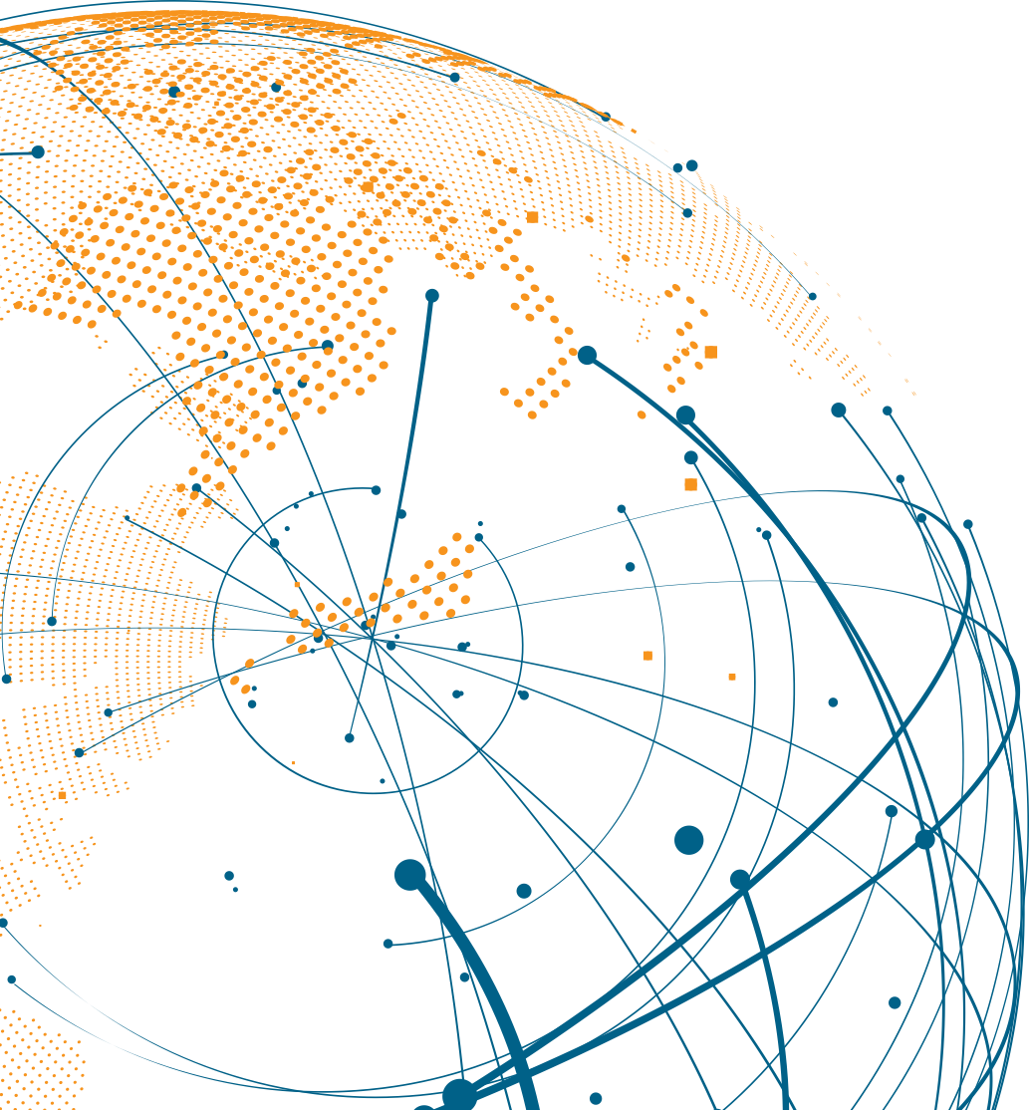

Barry I. Matherly, CEcD, FM, HLM
President & CEO, Hickey Global
+1 917-410-4626
bmatherly@hickeyglobal.com
125 Park Avenue, 25th Floor
New York, NY 10017
www.hickeyglobal.com
LOCATION STRATEGY | LABOR BENCHMARKING & ANALYTICS | GRANTS & INCENTIVES ADVISORY SUPPLY CHAIN & LOGISTICS | WORKFORCE SOLUTIONS

